Slide 1

r
BUILD IT WITH AI
EXERCISE YOUR CREATIVITY AND GET STUFF DONE
Franklin University
Teresa Thompson
RCoB AI Digital Retreat
September 28, 2026
Faculty, West Valley College
President, TACTYC

Slide 2
TODAY
WHAT?
Use AI to build tools and applications
WHY?
To engage students in meaningful ways
BECAUSE
The work we do as educators matters. Anything that helps us do more of it effectively, and with joy, is worth exploring.

Slide 3
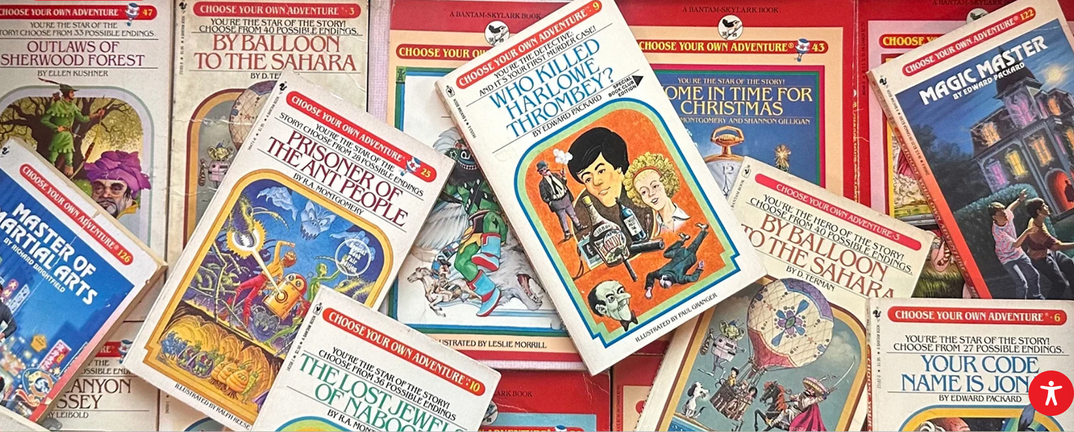
r
REMEMBER THESE?
Notes:
1969: Ed Packard invents the multi-path narrative structure during bedtime storytelling when his daughters disagree on how a plot should proceed.
300 Choose Your Own Adventure books, over 270 million copies sold

Slide 4

r
STILL POPULAR
Notes:
In 2023 A Stranger Things series was released with over 40 possible endings.

Slide 5

r
STILL POPULAR

Slide 6
FORMAT
YOU CHOOSE
1
When prompted, type your selection into the chat.
FOLLOW THE WINNING PATH
2
Learn more about the topic you select with examples and resources.
PATHS MAY RETURN
3
Unselected topics may show up as options later.
Ready ?
?

Slide 7
TRIAL RUN
What do you most want AI to help with?
A
Save me time
B
Engage students
C
Create better materials
D
See what’s possible
Type your selection in the chat

Slide 8
c
ADVENTURE SCALE
Beginner
Moderate
More Adventurous

Slide 9

LET’S BEGIN
Notes:
It’s been a long day, and you realize you are tired and haven’t even made a dent in all your tasks. You rest your eyes for a moment and open them to find the walls of your office disappear. Your desk stretches into a winding, wooded trail. You love a good adventure, so you grab your backpack and start walking. The trail is surprislingly easy at first, though you do notice the woods getting darker and the terrain underfoot becoming more uneven. You continue on, round a corner and notice that…

Slide 10
You’ve reached a fork in the road…

Slide 11
CHOICE 1
Which path do you want to explore?
Path A
Path B
Adventure Level:
Adventure Level:

Slide 12
CHOICE 1
Which path do you want to explore?
Path A
Path B
Adventure Level:
Adventure Level:

Slide 13
CHOICE 1
Which path do you want to explore?
Path A
Path B
ChatGPT AS YOUR ASSISTANT
BUILD A QUIZBOT
Adventure Level:
Type your
choice
in the chat
Adventure Level:

Slide 14

A
BUILD A QUIZBOT
What’s a QuizBot?

Slide 15
A
BUILD A QUIZBOT
What’s a QuizBot?
A custom AI-powered practice tool that you provide the parameters for.
  Practice
  Feedback
  Learn
  Grow Confidence
  Repeat

Slide 16
WATCH IT IN ACTION
Prompt → Questions → Evaluates Response → Feedback → Keep Going

Slide 17

c

Slide 18

c
DO THEY USE IT?

Slide 19

c
DO THEY USE IT?

Slide 20
HOW TO BUILD IT
Gather your source material
1
  Textbook chapters
  Notes
  Study guide
  PowerPoint slides
  Practice problems
  Assignment instructions
Use PREP model for prompting
2

Slide 21
PREP MODEL
P
R
E
P
Notes:
Prompt –What do you want it to do? So we might say “Create a ChatBot that quizzes students with questions from Chapter 2.”
Role – Who should it act as? So we might say “Act as a supportive accounting tutor.:
Explicit –What specific directions should it follow? So “Ask students one question at a time, review student’s response, indicate whether the student’s selection is correct or incorrect and explain why”
Parameter –What boundaries should it stay within? So, “Use only the provided chapter material to create questions, keep the questions at an introductory level, and provide student with an option to advance to a new question”.

Slide 22
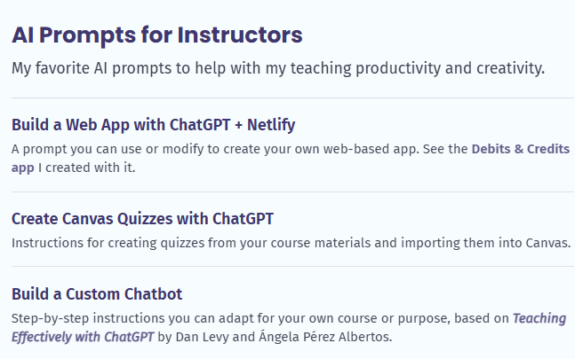
MY PROMPT
Download my QuizBot Prompt at:
ProfessorTeresaThompson.com
→ Resources
Professorteresathompson.com

Slide 23

CUSTOM CHATBOT
How could you use it?
  Practice quizzes
  Syllabus assistant
  Interactive tutor
  Project assistant
  Tips from former students
  Endless possibilities!

Slide 24
NEXT STEPS
  Think of how you want to use a custom chatbot.
  Get chatbot prompting instructions on my website -or create your own using the PREP method.
  Build it, test it, refine it, share it.
Download my QuizBot prompt at:
ProfessorTeresaThompson.com → Resources
Choice 2
Final Round

Slide 25

B
YOUR ASSISTANT
What can it help with?
  Organizing data
  Graphic design
  Synthesizing data
  Communication
  Website design
  Brainstorming
  Contingency planning
  Presentation design
  Overall assistant
  So much more!
What’s your favorite way to use AI as an assistant?
Drop it in the chat.

Slide 26
WATCH IT IN ACTION
Using it as an assistant to scour meeting minutes for answers

Slide 27
c

Slide 28

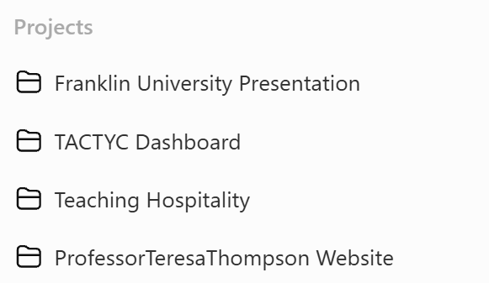
c
DO YOU USE IT?

Slide 29

c
HOW TO BUILD IT
  Organizing data
  Graphic design
  Synthesizing data
  Communication
  Website design
  Brainstorming
  Contingency planning
  Presentation design
  Overall assistant
  So much more!
Use PREP model for prompting
Choice 2
Final Round

Slide 30
CHOICE 2
Which path do you want to explore?
Path A
Path B
BUILD QUIZZES IN CANVAS
CREATING
A
DASHBOARD
Adventure Level:
Type your
choice
in the chat
Adventure Level:

Slide 31

A
BUILD QUIZZES
Has anyone ever built quizzes in Canvas from scratch?

Slide 32
WATCH IT IN ACTION
Simply prompt ChatGPT, review the questions, and import to Canvas

Slide 33
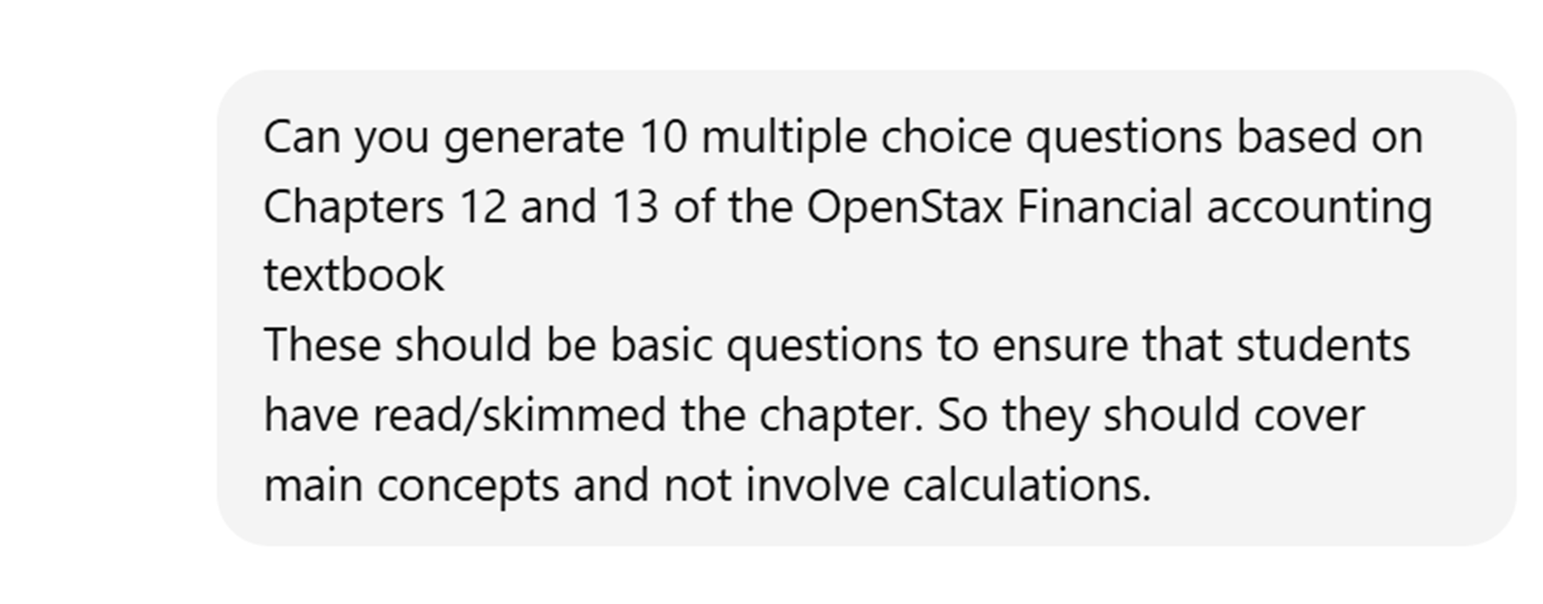
c

Slide 34
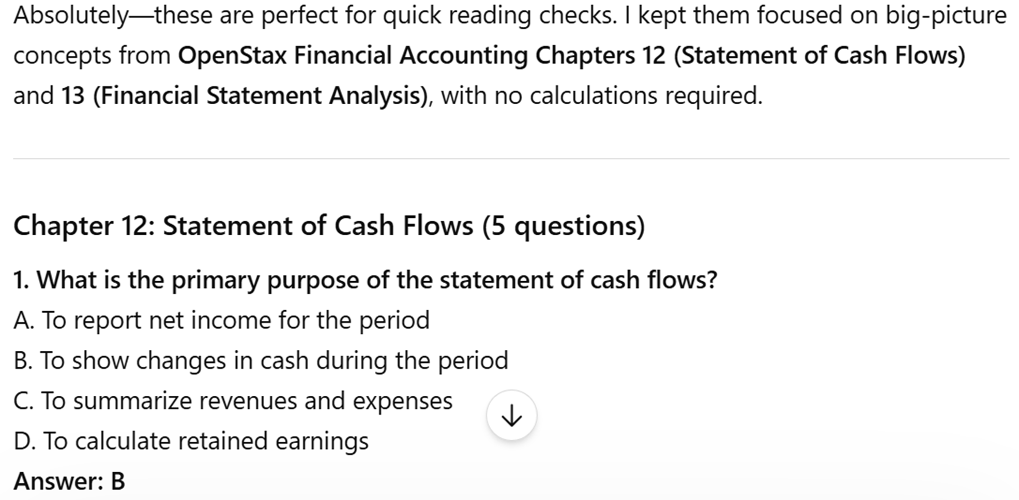
c

Slide 35
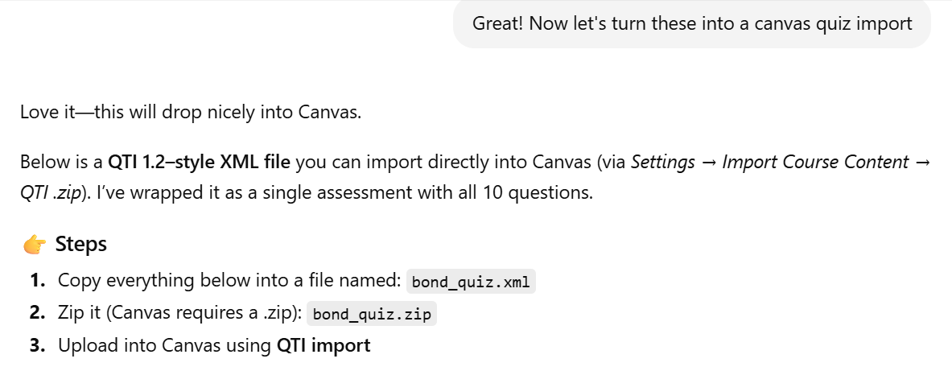
c

Slide 36
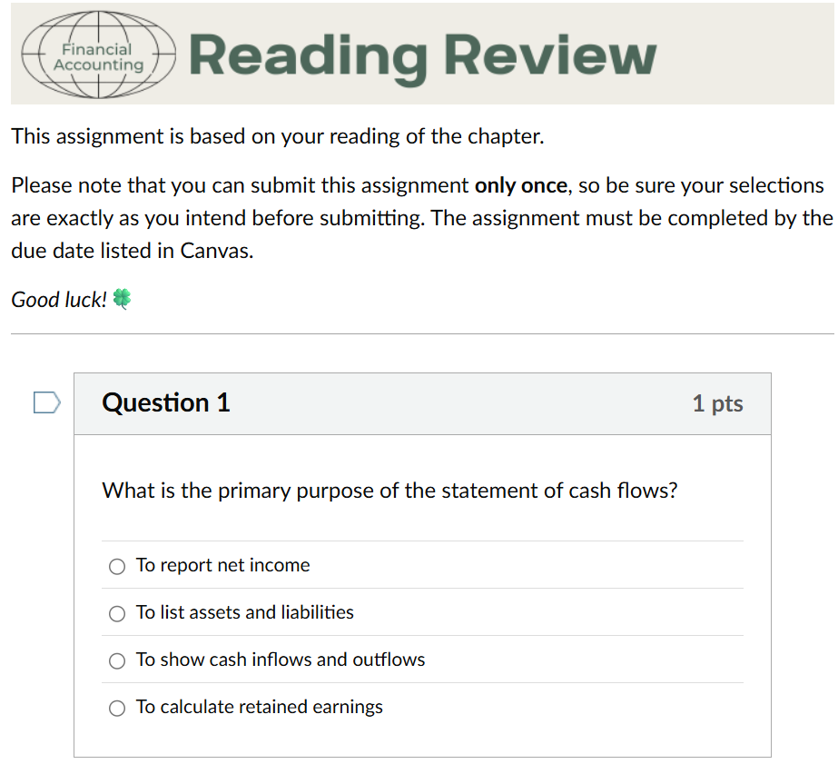
c

Slide 37
c
HOW TO BUILD IT
Download my prompt at:
ProfessorTeresaThompson.com
→ Resources
Choice 3
Final Round

Slide 38

B
DASHBOARD
An analytics dashboard is a visual display that brings important data and metrics together in one place.
Where might it be helpful?
  Committees
  Student clubs
  Business or side venture
  Household planning
  Volunteer groups

Slide 39

Site

Slide 40
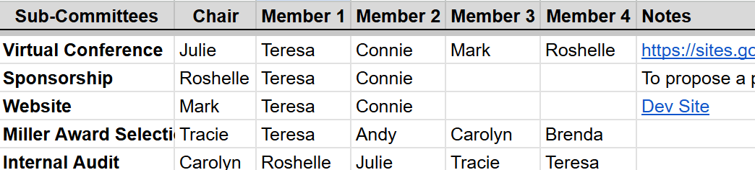
HOW TO BUILD IT
ChatGPT
Google Sheets
Apps Script (Extension in Google Sheets)

Slide 41
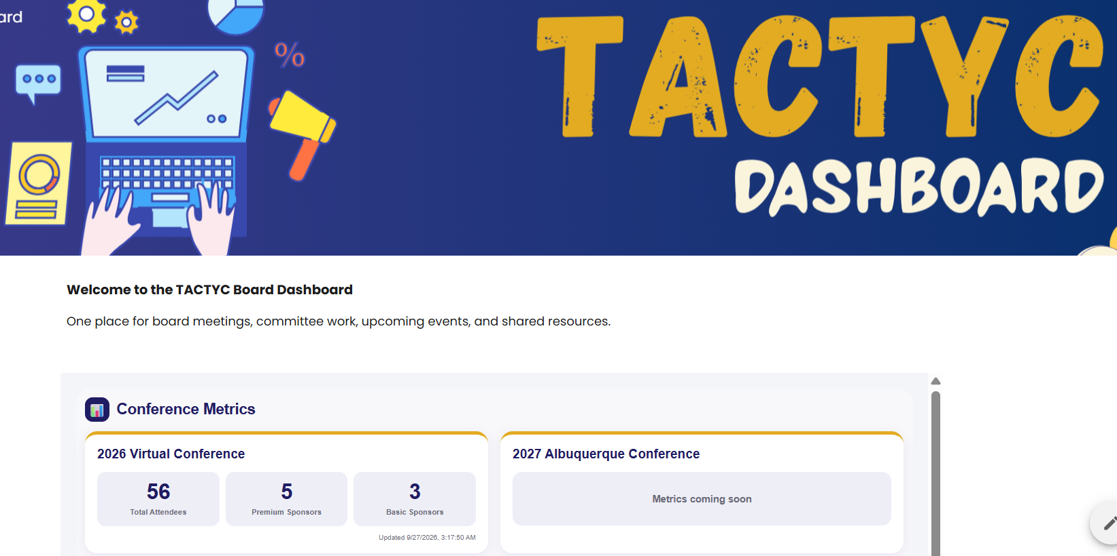
c
Choice 3
Final Round

Slide 42
c
CHOICE 3
Which path do you want to explore?
Path A
Path B
BUILD
A
WEBSITE
CREATE A
BOOKINGS
PAGE
Adventure Level:
Type your
choice
in the chat
Adventure Level:

Slide 43

A
BUILD A WEBSITE
Why might this be helpful?
  Class website
  Teaching resources
  Personal brand
  Business or consulting work

Slide 44

Professorteresathompson.com
Site

Slide 45
HOW TO BUILD IT
ChatGPT –or other gen AI
Web browser –Chrome, Edge, Safari
Hosting service –Netlify, GitHub, or Vercel
Domain name –optional but nice
5. Patience –not optional

Slide 46
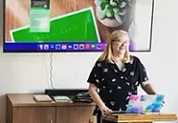


WHY BUILD IT
  Control
  Broaden your reach
  Communicate quickly
  People can see what you do
Final Round
Notes:
I had about 500 original visitors to my site last week

Slide 47

c
B
BOOKINGS PAGE
How many of you are busy?

Slide 48
WHY BUILD IT
Teach classes
Hold student hours
Committee work
Mentor faculty
Institutional responsibilities
Community programs
And on and on

Slide 49
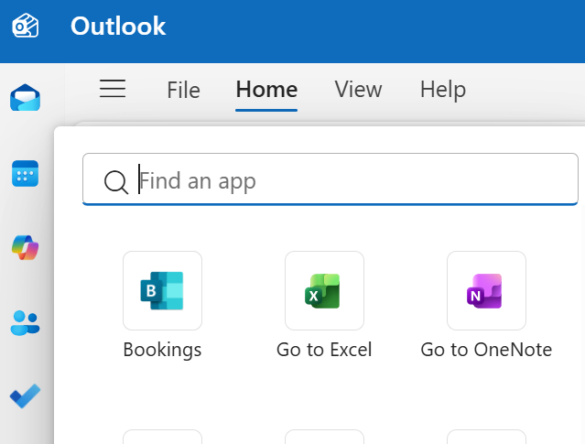
c
BUILD IT

Slide 50
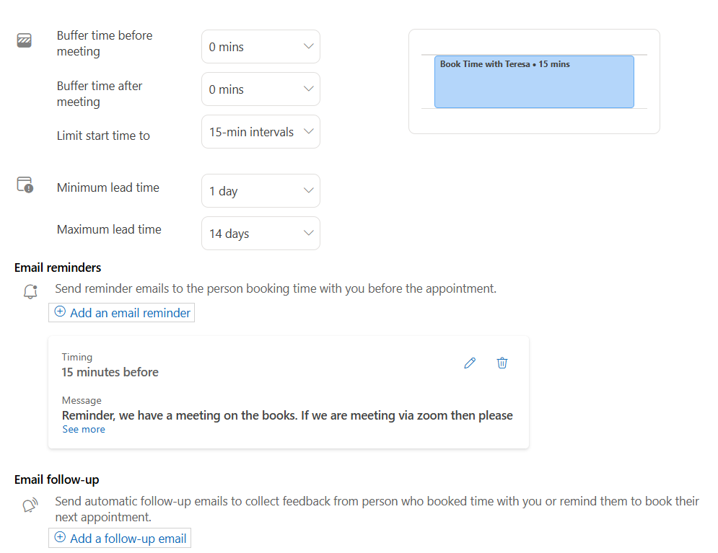
a
c

Slide 51
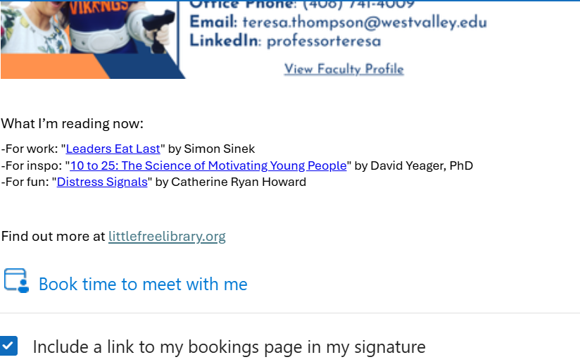
c
a
Outlook → Settings → Accounts → Signatures

Slide 52
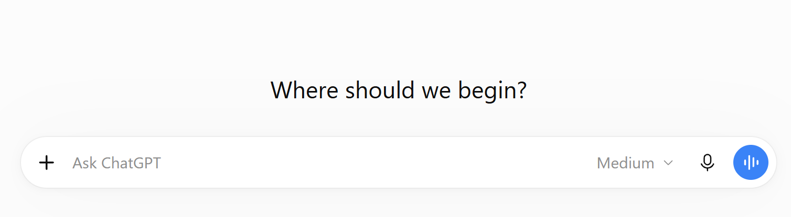
c
a
chatgpt.com
How do I create a bookings page in Outlook?
Final Round

Slide 53
FINAL ROUND
Path 1
Path 2
Path 3
Path 4
BUILD A QUIZBOT
ChatGPT AS YOUR ASSISTANT
BUILD QUIZZES IN CANVAS
CREATING
A
DASHBOARD
Adventure Level:
Adventure Level:
Adventure Level:
Adventure Level:
Path 5
Path 6
Path 7
Path 8
BUILD
A WEBSITE
CREATE A BOOKINGS
PAGE
LINKEDIN
LIKE
A PRO
CREATE COOL
QR CODES
Adventure Level:
Adventure Level:
Adventure Level:
Adventure Level:
Type your choice in the chat

Slide 54

LINKEDIN LIKE A PRO
Why?
  Extend your personal brand
  Stay connected with former students
  Reconnect with former colleagues and conference contacts
  Keep up on industry trends
  Model professional networking etiquette
Notes:
1.3 billion members worldwide

Slide 55
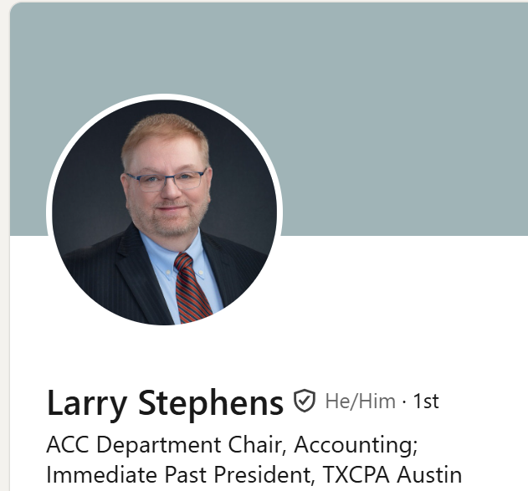
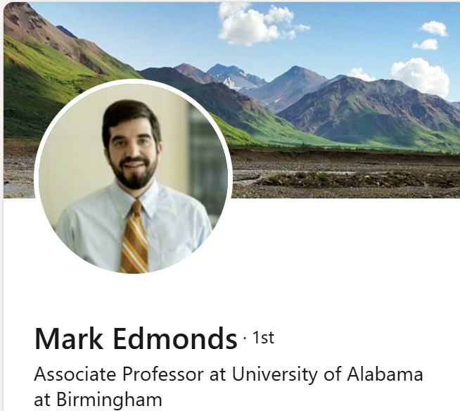
HOW?
www.linkedin.com/in/
larrygstephenscpa
www.linkedin.com/in/
mark-edmonds-267110294/
Which one is LinkedIn-ing like a pro?
Notes:
1.3 billion members worldwide

Slide 56
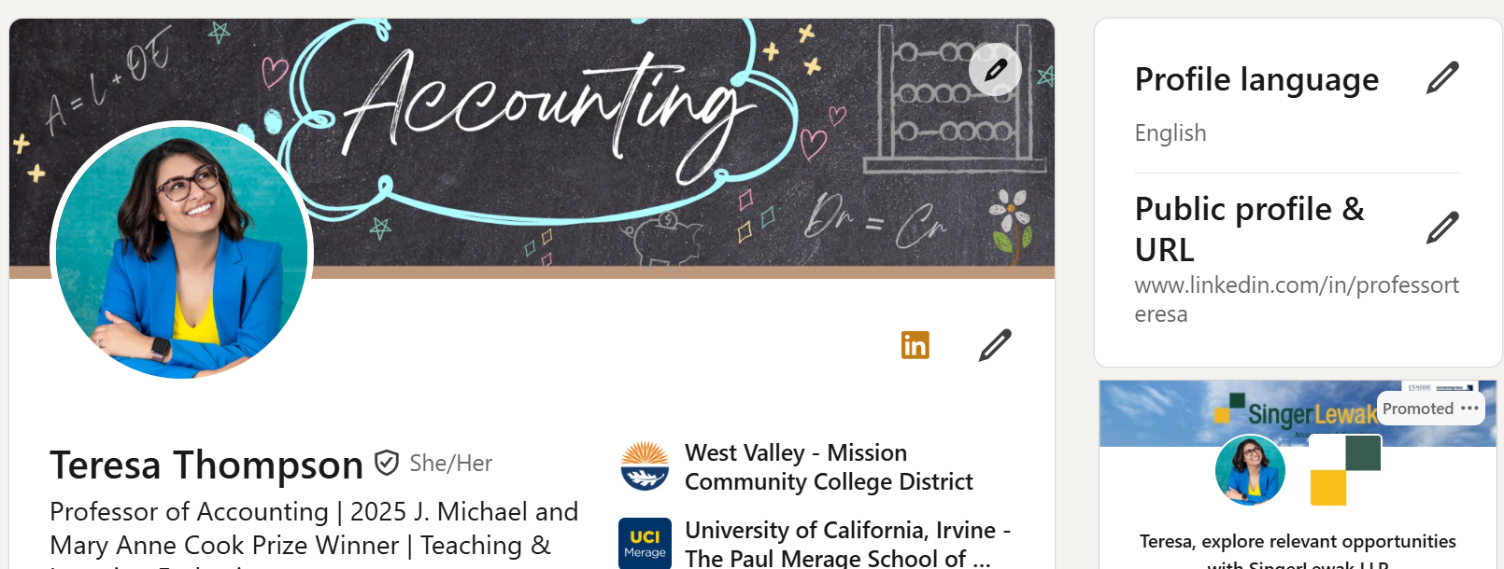
c
CUSTOMIZE YOUR URL
linkedin.com
Final Round
LinkedIn.com → Select your Profile → Click the pencil next to “Public Profile & URL”
Notes:
1.3 billion members worldwide

Slide 57


COOL QR CODES
QR, or Quick Response, codes are scannable shortcuts to connect someone to digital information.
Create right from your browser
Dedicated design program

Slide 58
HOW?
Get URL you want to turn into a QR Code
Go to QRCode-Tiger.com (free)!
Enter URL (from step 1)
Customize!
Final Round

Slide 59

Q&A
Ask me anything!
What’s your personal rule for deciding when AI can help?
Why didn’t you have AI make this presentation for you?
When was a time when AI just didn’t work for you?
What’s your favorite thing to use AI for?
Tell us about your most embarrassing moment?

Slide 60


KEEP IN TOUCH
c
Teresa Thompson
Email: professorteresathompson@gmail.com
Website: ProfessorTeresaThompson.com
LinkedIn: linkedin.com/in/professorteresa

Slide 61
FINAL ADVENTURE
We are going to make an app for that!
c

Slide 62
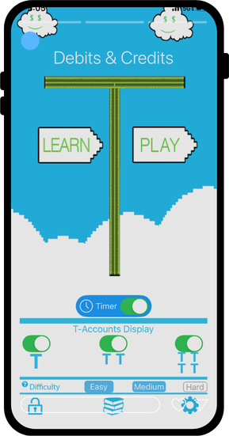

c

Slide 63
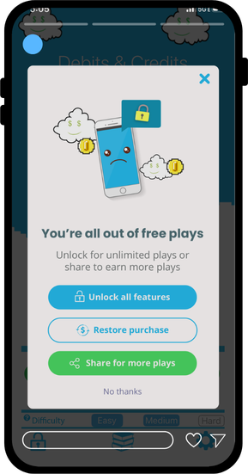

c

Slide 64

c

Slide 65
c

Slide 66
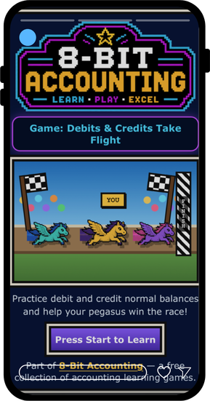
c

Slide 67
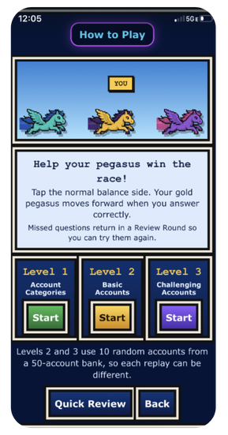
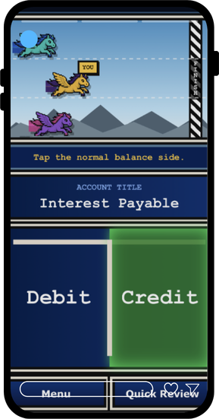
c

Slide 68
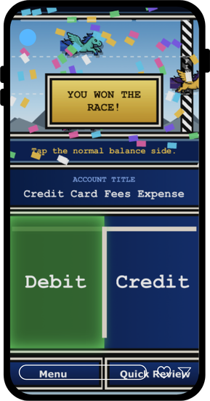
c

Slide 69
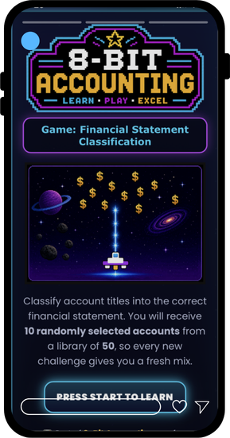
c

Slide 70
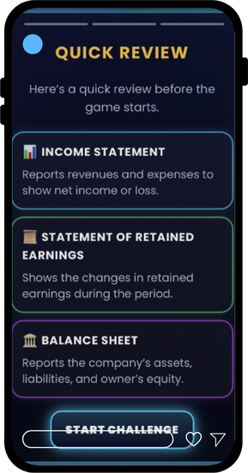
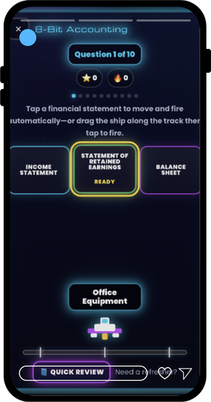
c

Slide 71
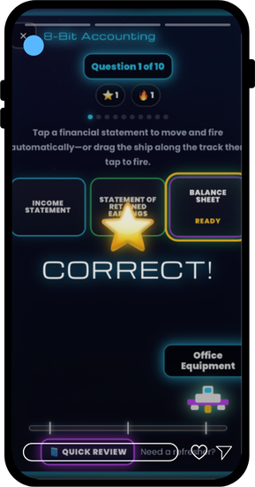
c

Slide 72


c

Slide 73

8-BIT ACCOUNTING
c

Slide 74
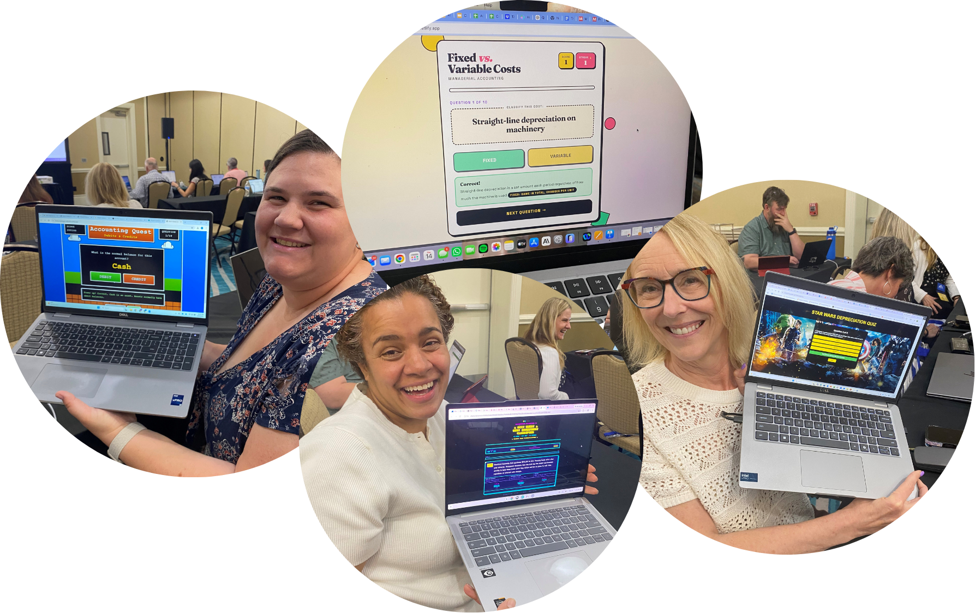
MUST BE SHARED
c

Slide 75
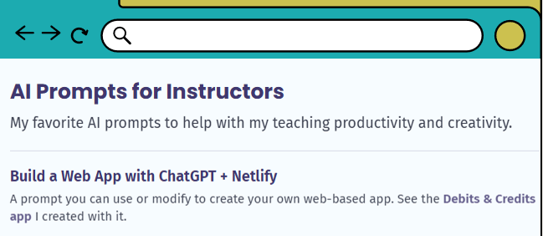
FINAL ADVENTURE
Think of a topic your students struggle with
Could you make an app to help them with it?
c
Professorteresathompson.com
Download my prompt at:
ProfessorTeresaThompson.com
→ Resources

Slide 76
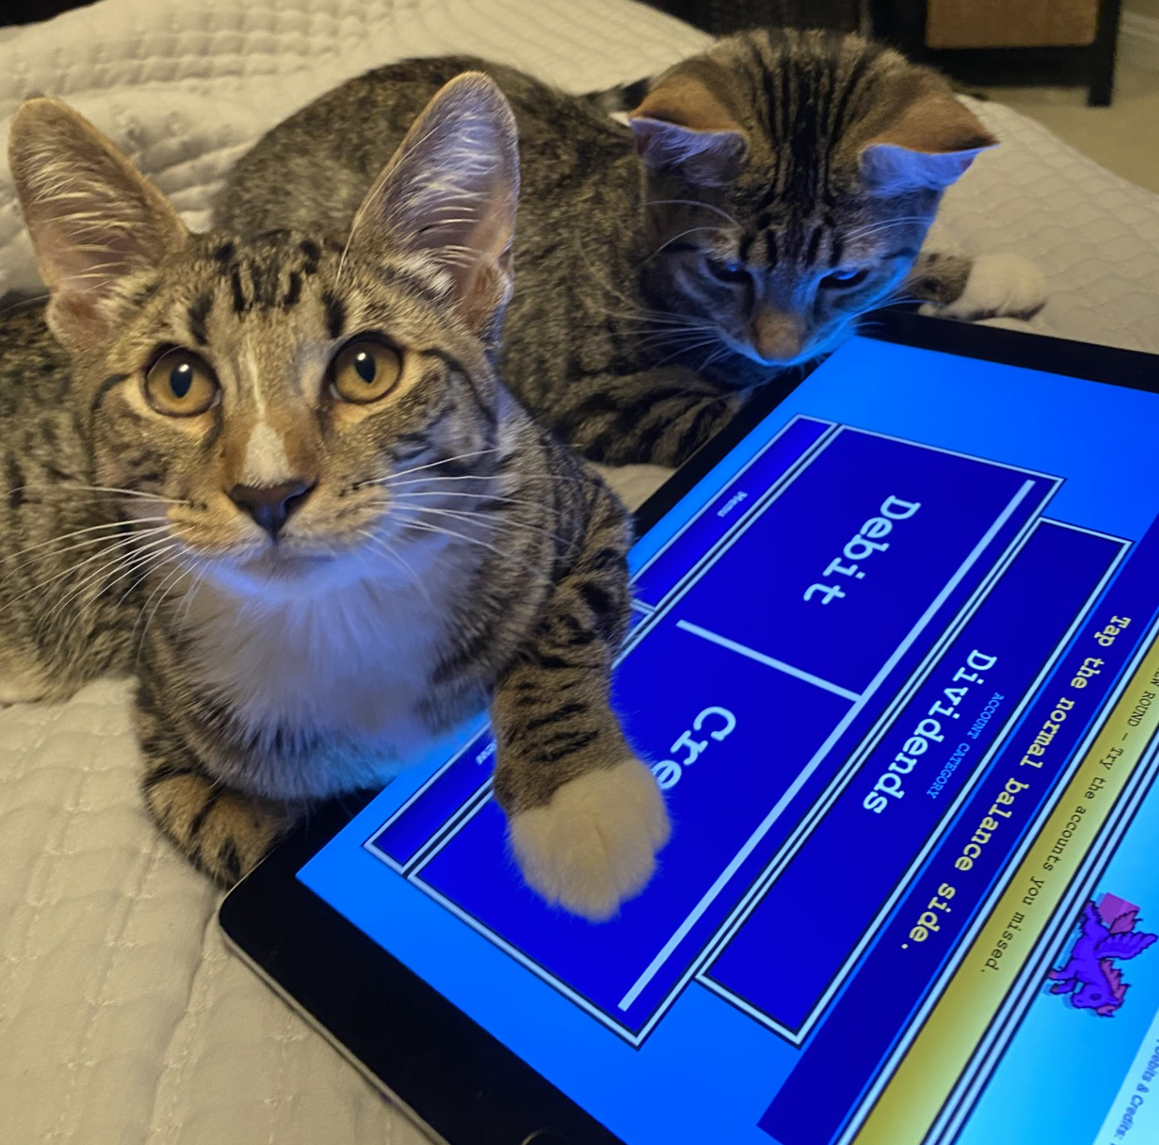
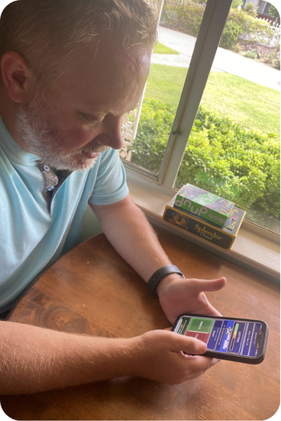

TIPS –QC A MUST!
c

Slide 77
Hope you’ve enjoyed your adventure
Thanks for playing

